Slide 1
(Short) Introduction to Machine Learning
Alberto TONDA, Senior Researcher (DR)
UMR 518 MIA-PS (Applied Mathematics and Computer Science) INRAE, AgroParisTech, Université Paris-Saclay Institut des Systèmes Complexes, Paris-Ile-de-France

Slide 2

Outline
What is machine learning
ML as optimization
Supervised ML
Unsupervised ML
Fighting overfitting

Slide 3
Machine learning (more proper definition)
Given a class of tasks T, a performance measure P, and experience E, a machine learning algorithm improves its performance measured with P, for tasks in T, using the experience E

Slide 4
Machine learning (more proper definition)
Given a class of tasks T, a performance measure P, and experience E, a machine learning algorithm improves its performance measured with P, for tasks in T, using the experience E

Slide 5
Machine learning as optimization
Learn a task directly from examples
No need for symbols, just large quantities of data
Samples (rows) and features (columns)
“Dirty secret” of ML: it’s mostly optimization
Restate learning task as optimization task
Solve it relying on available (training) data
Learning Task
Optimization Task

Slide 6
Machine learning as optimization
What does “restating” the problem mean?
Variables to optimize: parameters of the model
Create an objective function related to your learning problem
Optimizing the objective function also solves your problem
Types of machine learning
Supervised: we have labeled data (correct answers, ground truth)
Most common tasks: classification, regression
Unsupervised: we do not have labeled data
Most common tasks: clustering, dimensionality reduction

Slide 7

Supervised machine learning
How would you construct our objective function for ML?

Slide 8
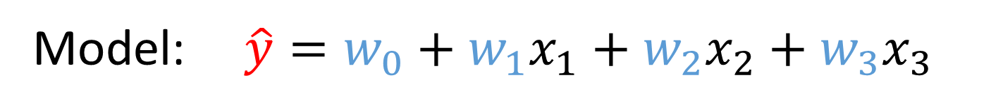

Supervised machine learning
Regression
Minimize (squared/abs) difference predictions - training data
Way of optimizing depends on the structure of the model
After optimization, R1 is usually used as a metric of quality
Features: $y, x_{1},x_{2},x_{3}$
Model: $\hat{y}=w_{0}+w_{1}x_{1}+w_{2}x_{2}+w_{3}x_{3}$
Optimization task: $argmin(\sum_{i=0}^{N}{| \hat{y}(i) −y(i) |)}$

Slide 9
Supervised machine learning
Classification
During training, often treated as continuous optimization
E.g. interpret continuous output as probability
Accuracy: % of correct answers
F1 and Matthew’s Correlation Coefficient are better

Slide 10

Overfitting and regularization

Slide 11

Unsupervised machine learning
There is no ground truth, no labels; what can we optimize?

Slide 12
Dimensionality reduction

Slide 13
Autoencoders

Slide 14
Clustering
State-of-the-art algorithms
Hierarchical agglomerative clustering
Density-Based Spatial Clustering of Applications with Noise (DBSCAN)
Hierarchical DBSCAN

Slide 15
Practical issues with machine learning
Algorithms find correlations not causal relationships

Slide 16

Practical issues with machine learning
Black-box effect

Slide 17




Societal issues with machine learning
Ethical implications
Bias in the data
Black-box effect
Unintended consequences
Further reading (divulgation)
https://callingbullshit.org/
Weapons of Math Destruction
The Age of Surveillance Capitalism
Toxic Data

Slide 18
Practical advice (July 2023)
Supervised ML
Try all the algorithms with default values, pick the best
Or run “AutoML” approaches (next class)
If you do not have the time to do that
For images: a convolutional neural network (CNN)
For text: transformer neural networks
For tabular data: XGBoost, LightGBM, or Random Forest
For time series: …nothing really works better than other systems

Slide 19
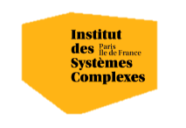

Questions?
Bibliography - Kochenderfer & Wheeler, Algorithms for Optimization, MIT Press, 2019 - De Jong, Evolutionary Computation: A Unified Approach, 2016
Images and videos: unless otherwise stated, I stole them from the Internet. I hope they are not copyrighted, or that their use falls under the Fair Use clause, and if not, I am sorry. Please don’t sue me.

